Slide 1

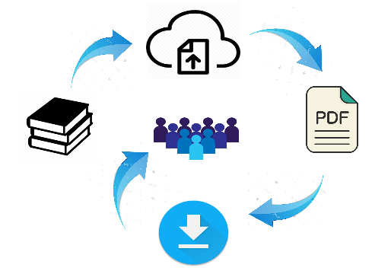
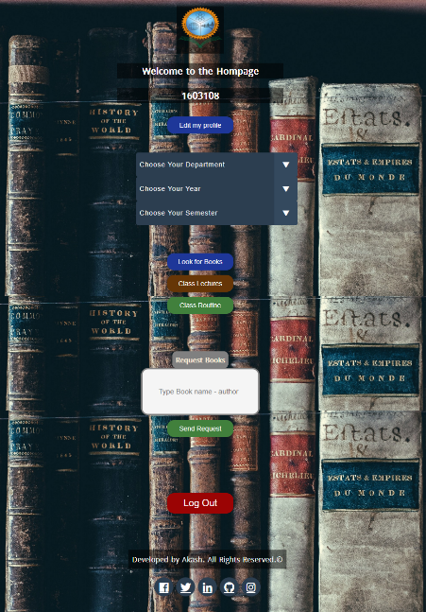
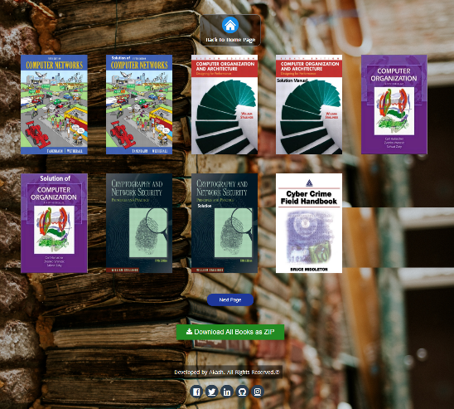
RUET Online Book and Class Notes Store
Features and Interface of the Website
Students can Signup with their student ID
and other info and login with ID & password.
After login students can select the dept , year and semester and click “Look for Books”.
In the next page, all the books of that corresponding semester will be available to download.
Student can download routine and class-notes as well. This will make the collection of books in each semester much more easier than before.
What is RUET Online Book and Class Notes Store ?
An online website where all the class lectures, books, routines of each and every semester of different departments of RUET can be found and downloaded.
Equipments needed for the project
Operating System (Windows 10)
Sublime Text as Editor
XAMPP as Hosting server
PHPMyAdmin for using Database
PHP, HTML, CSS,JavaScript etc as the programming languages for Coding and designing stuff.
Md Shabir Khan Akash
1603108

